Slide 1
Goals & Overview
Goals:
Basic concepts.
Workflow
i) Creating a new project.
ii) How to collaborate with others?

Slide 2
Goals & Overview (contd)
Overview:
Key concepts.
How to setup and configure?
Initialize a project.
Working in local.
Working remote.
Common interview questions.
Miscellaneous topics.

Slide 3
Prerequisites
A laptop or a PC.
Admin rights over the machine.
Good internet connection.
Zeal to lean.

Slide 4
Key Concepts
Repository
Repositories in GIT contain a collection of files of various versions of a Project.
Types :
- Bare repositories.
- Non-bare repositories.
Commit
- Saved changes to the repository.
- Unique code or identifier (SHA1).

Slide 5
Key Concepts (contd)
Branches
- A stream or a timeline with commits
- main/master is the first branch (default)
Head
- Last commit pointer
Remote
- Not a local repository, but, related
- Eg – Bit-Bucket, Azure Repos, AWS CodeCommit, GitLab, GitHub, etc

Slide 6
Key Concepts (contd)
Working area
It is the collection of files which are originated form a certain version of the repository. It helps in tracking the changes done by a specific user on one version of the repository.
Stages
- Untracked: Never staged nor committed.
- Tracked: File is committed but not staged.
- Staged: Ready to be committed, placed in the staging area.
- Modified/Dirty: File is modified but the change is not yet staged.

Slide 7
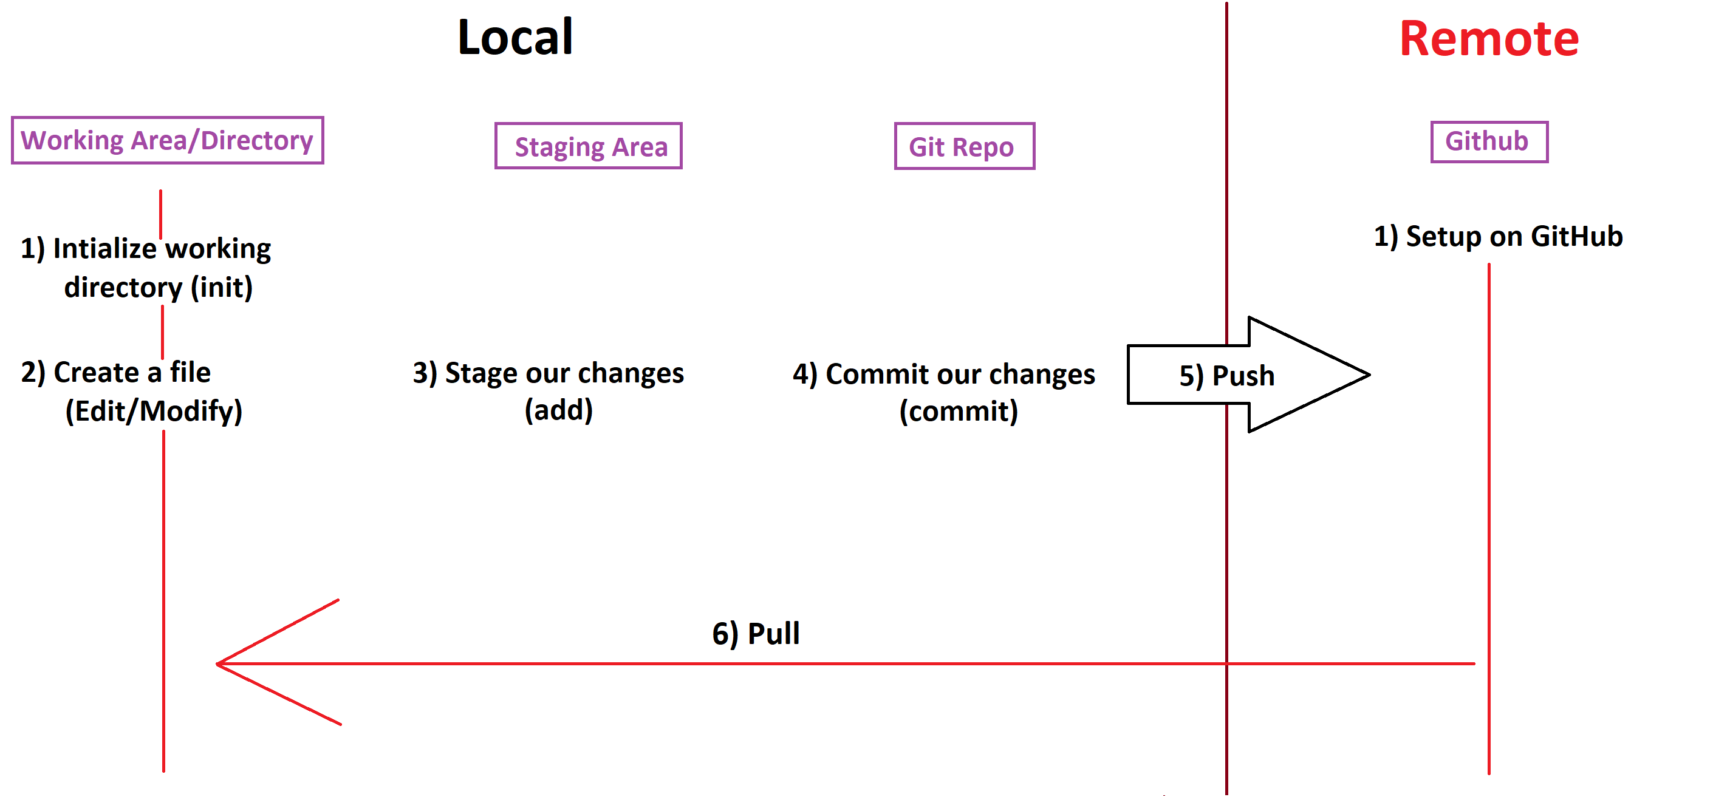
Workflow (Local)

Slide 8
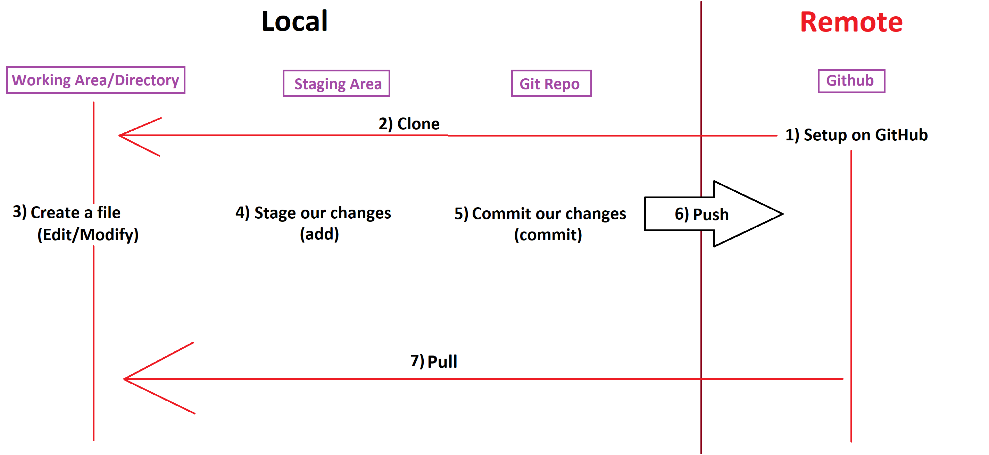
Workflow (Remote)

Slide 9
Git and its installation
What is Git?
Git is a free and open-source distributed version control system designed to handle everything from small to very large projects with speed and efficiency.
Git is easy to learn and has a tiny footprint with lightning-fast performance. It outclasses SCM tools like Subversion, CVS, Perforce, and ClearCase with features like cheap local branching, convenient staging areas, and multiple workflows.

Slide 10
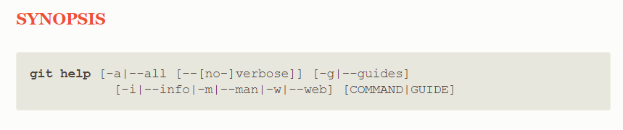
Git help
Git help
It displays help information about Git.

Slide 11
Git Config
Git name
Git e-mail address
Usage of “git config --global”

Slide 12
Initializing a repository
Creating a new project
Syntax : git init “Your-Project-Name”
Working on an existing project
Syntax : git init

Slide 13
Working locally
What is git commit and how to execute it?
What is git status?
What is git add?
Can we commit and add at the same time?

Slide 14
Add Multiple Files|Unstage | Discard
Adding multiple files through one command
How to unstage a file
Discard changes in your working area

Slide 15
Checking History and Removing Files
How to check the Git commit history?
How to remove files
a) Using Git
b) Without using Git

Slide 16
Moving and Ignoring Files
Moving Files
- How to move files within directories
Ignoring Files
- These are the files that you do not want in your version control

Slide 17
GitHub - Going Remote
GitHub
- What is GitHub?
- Workflow in GitHub
- Account creation
- Creation of our first repository
- Cloning a sample repository in local

Slide 18

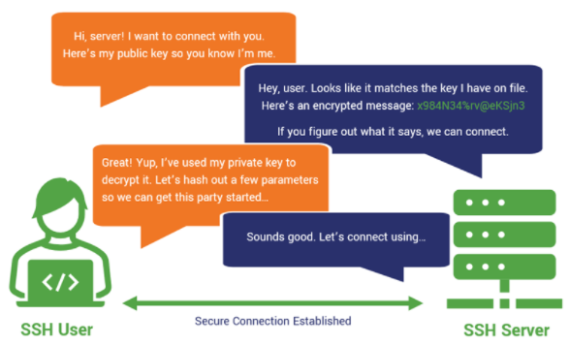
SSH Authentication
- What is SSH?
- How does it work?
- SSH key creation
- Updating GitHub with our key

Slide 19
Git Remote
- Creation of same repository in GitHub?
- Pushing our repository to GitHub
- Initial setup
- Pulling changes

Slide 20
Branches
Branch creation
- Through GitHub
- Through local
Pushing branches
Pull Requests
Merging branches

Slide 21
Interview Questions
What are the advantages of using a command line?
How to uniquely identify a commit?
What’s the default branch in any git repository?
What are the other git hosting providers?
Is there any difference in git commands if I use them on Mac or Windows?
Passphrase is a must while creating SSH key?
What are the commands to use while communicating with remote git repo?
Why do we need –u parameter in git commands?
Why is it recommended to issue the git pull command immediately before git push?
How to create a branch in git?

